Slide 1
CSCI 4430 – Fall 23
Tutorial 13

Slide 2
Data Link Layer
Protocols
Ethernet (IEEE 802.3)
CSMA (Carrier-sense multiple access)/CD (Collision detection)
Recover after collision is detected
Wi-Fi (IEEE 802.11)
CSMA/CA (collision avoidance)
Designed to avoid collision
etc.
Device working in this layer use MAC address

Slide 3
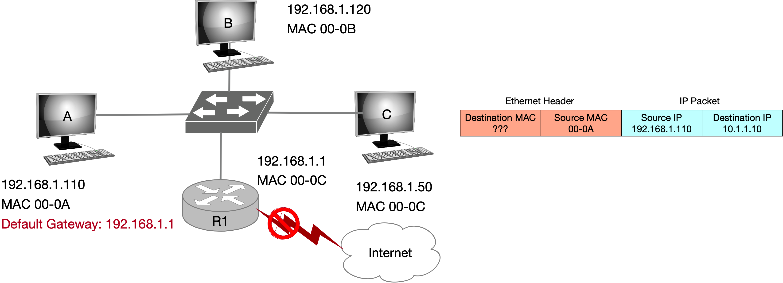
Address Resolution Protocol (ARP)
Used to find the MAC address of another device within subnet
ARP cache: A list from IPv4 address (32 bits) to MAC address (48 bits)
ARP broadcast address (when sending an ARP finding request): ff:ff:ff:ff:ff:ff

Slide 4
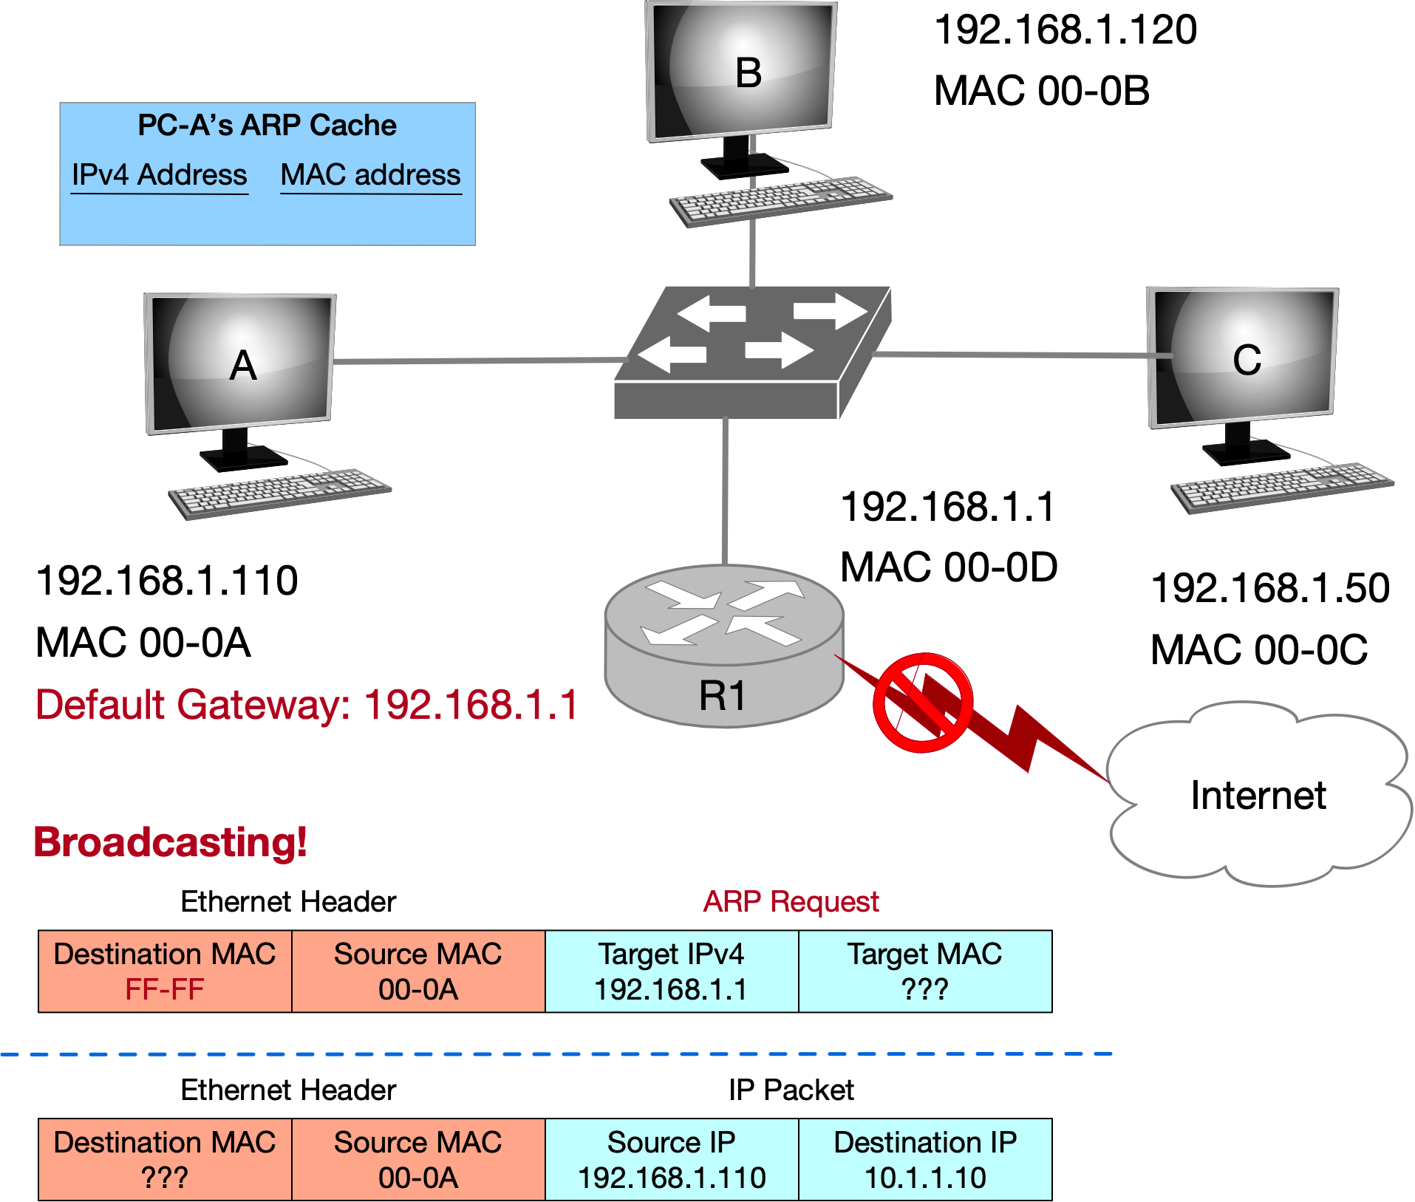
Address Resolution Protocol (ARP)

Slide 5
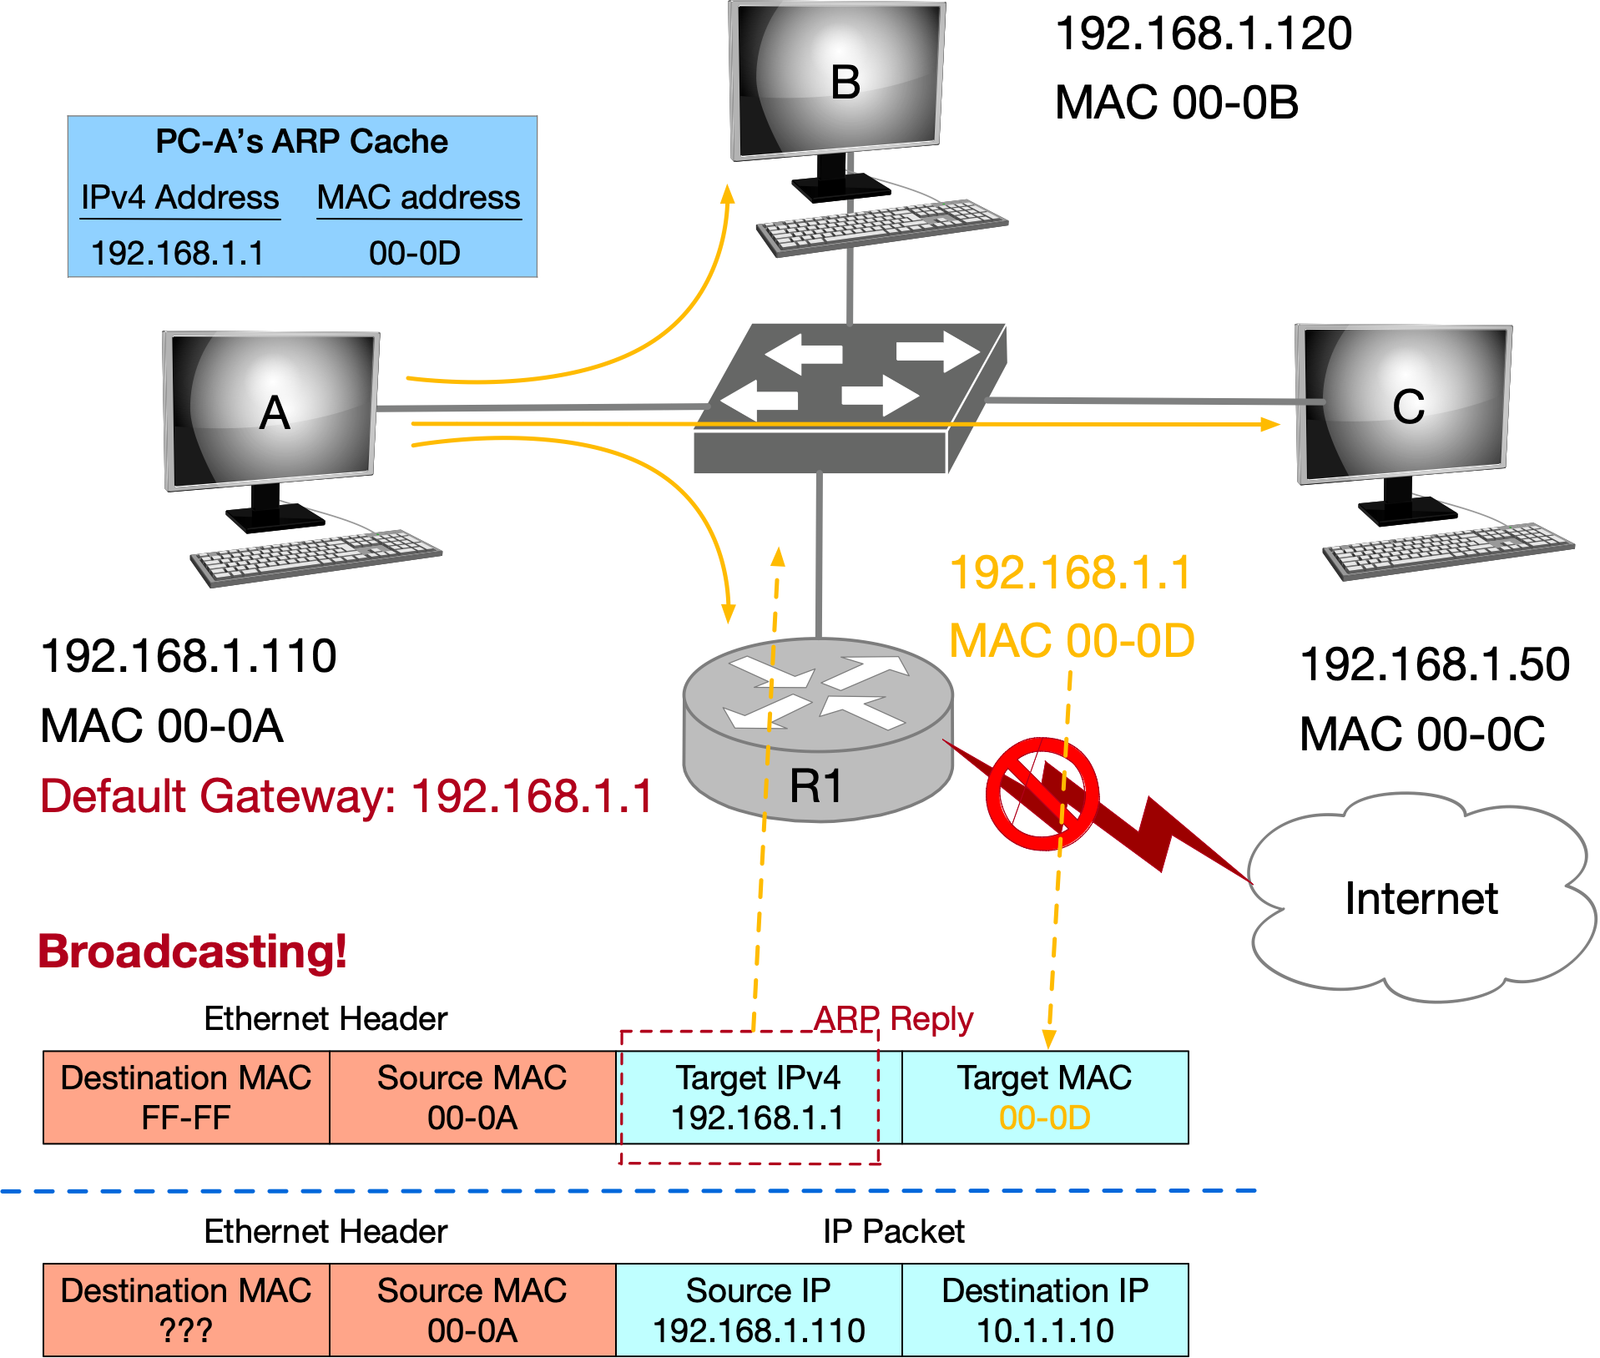
Address Resolution Protocol (ARP)

Slide 6
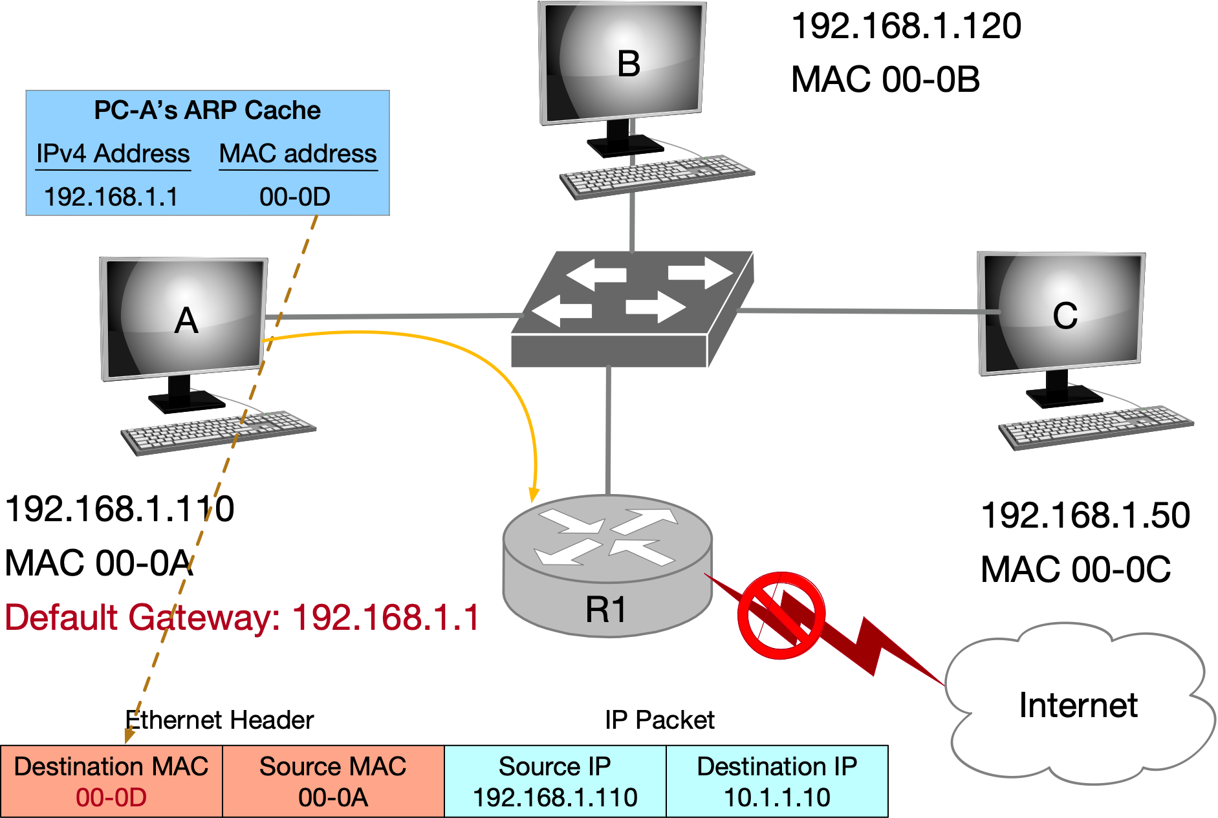
Address Resolution Protocol (ARP)

Slide 7
Spanning Tree Algorithm
Used to broadcast messages of switches in subnets and avoid loops
Aimed to construct a spanning tree of the topology
Messages (Y, d, X) (Each node)
From node X
Proposing Y as the root
Advertising distance d to Y
(Each node) Advertising Messages to its neighbors.
Switches elect the node with smallest identifier (MAC address) as root.
Each switch determines if a link is on its shortest path to the root; excludes it from the tree if not.
Breaking ties: choose the lowest switch ID.

Slide 8
Spanning Tree Algorithm
Algorithm Procedure
Initially, each switch proposes itself as the root
Switch X announces (X, 0, X) to its neighbors
Switches update their view of the root
Upon receiving (Y, d, Z) from Z, check Y’s id
If Y’s id < current root: set root = Y
Switches compute their distance from the root
Add 1 to the shortest distance received from a neighbor
If root or shortest distance to it changed, send neighbors updated message (Y, d+1, X)

Slide 9
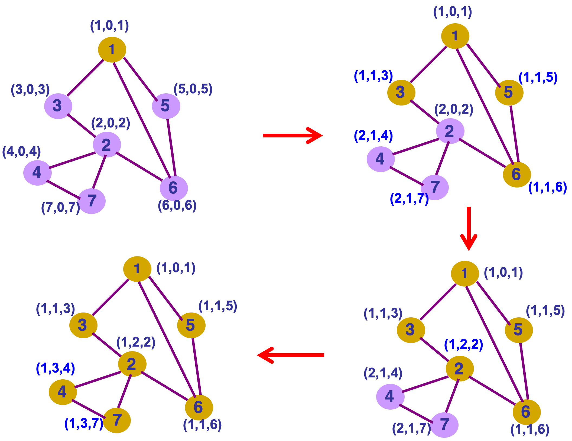
Switch root (compare id with neighbors)
distance = neighbor distance + 1
Initialize
update
Switch root (compare id with neighbors)
distance = neighbor distance + 1
update
update
Switch root (compare id with neighbors)
distance = neighbor distance + 1
Breaking ties: lowest neighbor ID
Breaking ties
3. Tree completed (coverage)

Slide 10
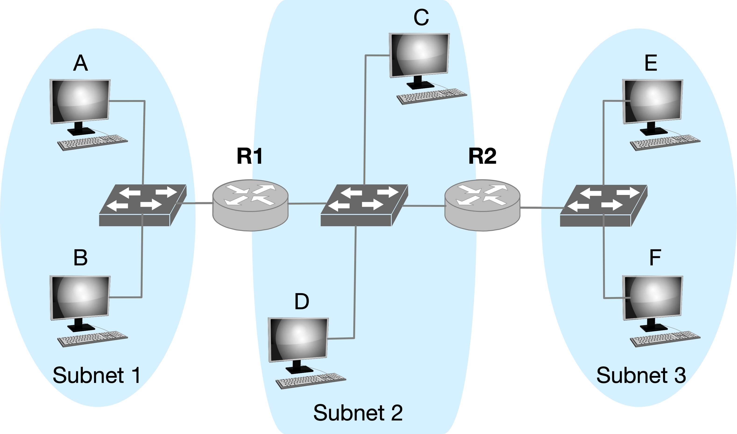
Q1 Forwarding
Consider sending an IP packet from Host E to Host F. Will Host E ask router R2 to forward the packet? Why?
No. Host E and Host F are on the same subnet and are connected via switch.

Slide 11
Q2 ARP
2-1. Consider E sending an IP packet to B. Assume E’s ARP cache is empty. Will E make an ARP request to find B’s MAC address?
No. Host B and Host E are on the different subnets.
2-2. Will E make an ARP request to? If yes, to whom?
R2 (its first-hop router).

Slide 12
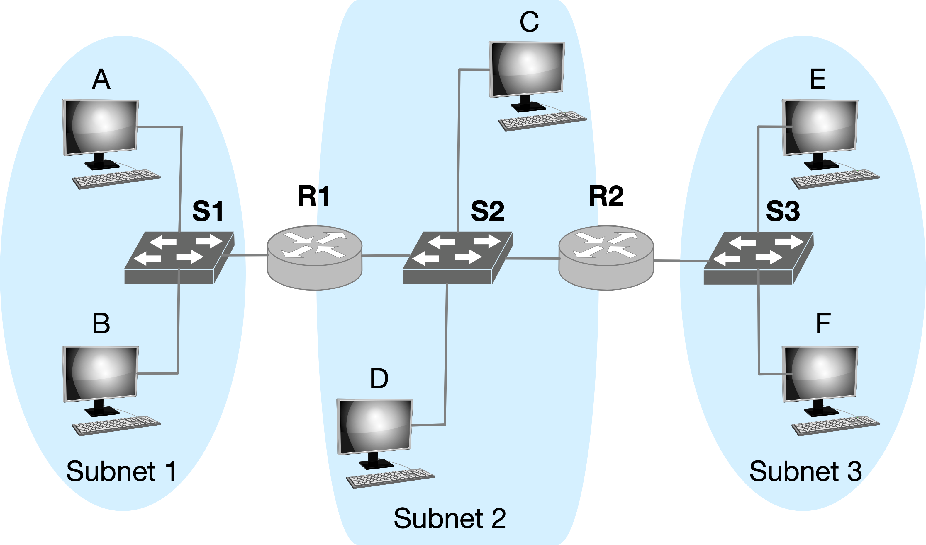
Q3 ARP and IP
Consider E sending an IP packet to B.
In the Ethernet frame of the IP packet from E to B is being delivered to router R1, what are the source and destination IP and MAC addresses?
srcIP: IP-E, dstIP: IP-B
srcMAC: MAC-R2, dstMAC: MAC-R1

Slide 13
Thanks!

